Slide 1
Digital Portfolio
STUDENT NAME: MOHANRAJ N
REGISTER NO AND NMID: 20924U09120 & C6145282998F96EB76B478CF867CDA2C
DEPARTMENT: BACHELOR OF COMPUTER APPLICATION
COLLEGE: SHANMUGA INDUSTRIES ARTS & SCIENCE COLLEGE

Slide 2
PROJECT TITLE
Personal portfolio

Slide 3


AGENDA
Problem Statement
Project Overview
End Users
Tools and Technologies
Portfolio design and Layout
Features and Functionality
Results and Screenshots
Conclusion
Github Link
3/21/2024 Annual Review

Slide 4

PROBLEM STATEMENT
Could you please clarify or share the full problem statement you want help with? Are you referring to a math problem, programming task, engineering issue, or something else? Provide the details and I’ll explain or solve it thoroughly.

Slide 5

PROJECT OVERVIEW
Please share more details about your Project Overview—such as the topic, purpose, goals, scope, and any specific requirements. Here’s a general template you can fill out or adapt for your project Project Overview Project Title: [Enter the title of your project] Background: Provide some context or background

Slide 6

WHO ARE THE END USERS?
End users are the individuals or groups who will ultimately use or benefit from the product, service, or solution developed by the project. Understanding their needs, preferences, and limitations is critical for the project’s success.

Slide 7

TOOLS AND TECHNIQUES
This section outlines the software, hardware, programming languages, frameworks, and other tools that will be used to design, develop, and deploy the project. The selection of tools and technologies should align with the project’s objectives, scope, and end users’ requirements.

Slide 8
POTFOLIO DESIGN AND LAYOUT
A well-structured portfolio is essential to showcase your skills, experience, projects, and achievements in a visually appealing and easy-to-navigate manner. Below is a comprehensive guide to designing and laying out your portfolio effectively.
8

Slide 9
FEATURES AND FUNCTIONALITY
This section outlines the key features and functionalities your portfolio will include. These elements ensure the portfolio is not only visually appealing but also interactive, informative, and user-friendly.

Slide 10
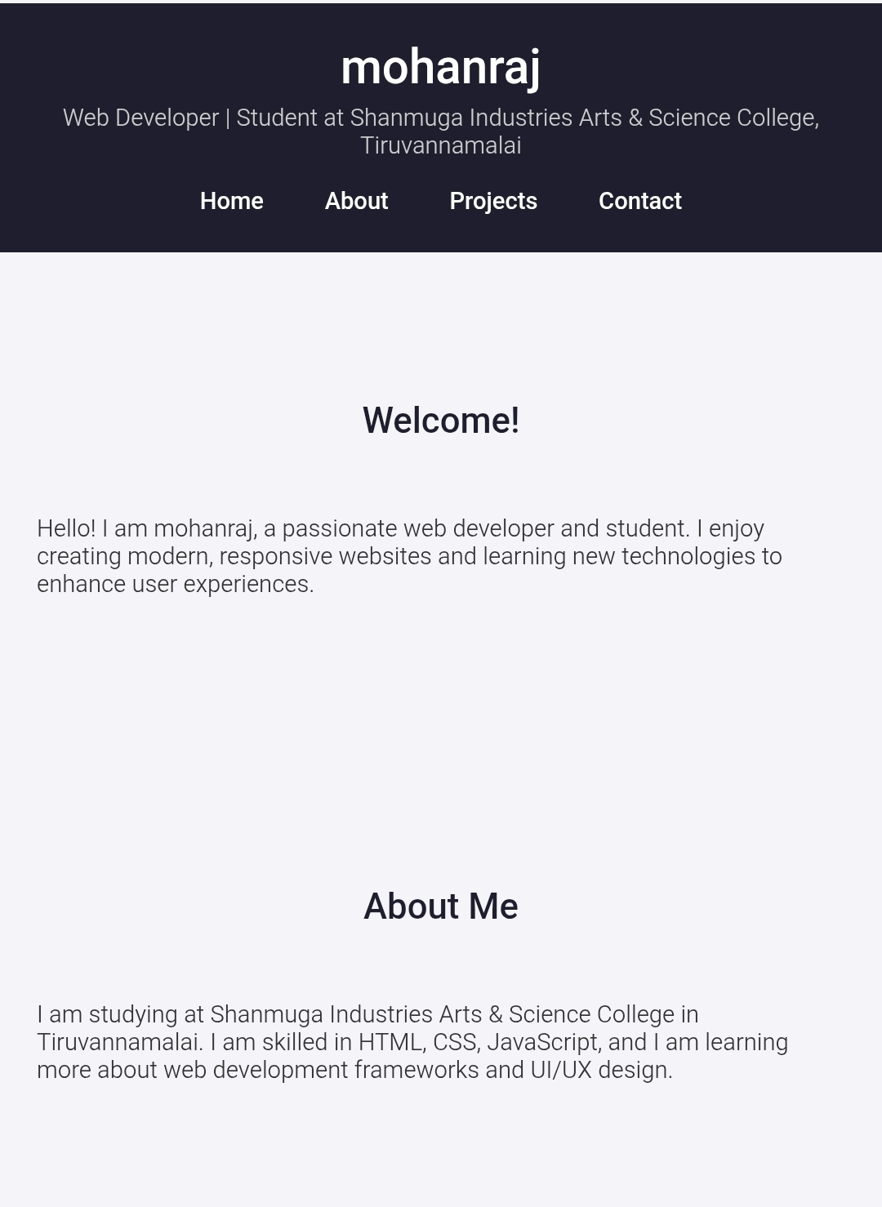

RESULTS AND SCREENSHOTS
3/21/2024 Annual Review
10

Slide 11
CONCLUSION
The portfolio project successfully achieves its goal of creating a professional, accessible, and engaging platform to showcase skills, experience, and projects. By combining thoughtful design, intuitive navigation, and optimized performance, it effectively communicates the creator’s strengths and makes it easier for potential employers, clients, or collaborators to connect and explore the work.
11

